Slide 1
Amiraj College of Engg. And Technology Biodiesel fuel:fuel for future
PRESENTED BY,
DHAVAL TRIVEDI
CIVIL- SEM1
ENROLLMENT NO = 131080106011

Slide 2
Key Biodiesel Questions
HISTORY OF BIODIESEL FUEL.
WHAT IS BIODIESEL FUEL?
PRODUCTION OF BIODIESEL FUEL
CHEMICAL REACTION
USES OF BIODIESEL FUEL
ADVANTAGES OF BIODIESEL
DISADVANTAGES OF BIODIESL

Slide 3
HISTORY
Transesterification of a vegetable oil was conducted as early as 1853 by Patrick Duffy, many years before the first diesel engine became functional.
Rudolf Diesel's prime model, a single 10 ft (3 m) iron cylinder with a flywheel at its base, ran on its own power for the first time in Augsburg, Germany, on 10 August 1893 running on nothing but peanut oil.
In remembrance of this event, 10 August has been declared "International Biodiesel Day

Slide 4
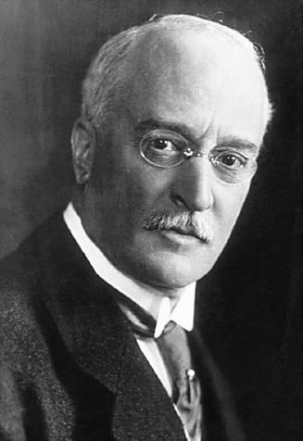
RUDOLF DIESEL

Slide 5
WHAT IS BIODIESEL?
Biodiesel refers to a vegetable oil- or animal fat-based diesel fuel consisting of long-chain alkyl (methyl, ethyl, or propyl) esters. Biodiesel is typically made by chemically reacting lipids (e.g., vegetable oil, animal fat) with an alcohol producing fatty acid esters.
Biodiesel is meant to be used in standard diesel engines and is thus distinct from the vegetable and waste oils used to fuel converted diesel engines.
The National Biodiesel Board (USA) also has a technical definition of "biodiesel" as a mono-alkyl ester.

Slide 6
BLENDS
Blends of biodiesel and conventional hydrocarbon-based diesel are products most commonly distributed for use in the retail diesel fuel marketplace.
Much of the world uses a system known as the "B" factor to state the amount of biodiesel in any fuel mix;

Slide 7
100% biodiesel is referred to as B100, while
20% biodiesel, 80% petrodiesel is labeled B20
5% biodiesel, 95% petrodiesel is labeled B5
2% biodiesel, 98% petrodiesel is labeled B2.

Slide 8
Emission Reductions

Slide 9
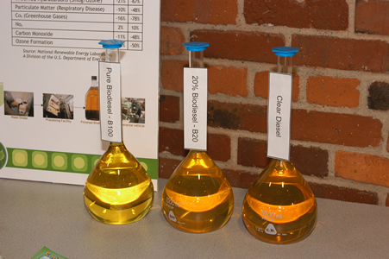
Biodiesel – Feedstocks
Vegetable oils
Soy, canola
Other oils
Palm, coconut, fish
Animal fats
beef tallow, sheep tallow, pork lard, poultry fats
Recycled waste grease
yellow grease (used cooking oil)
trap greases

Slide 10
Biodiesel Manufacturing
Biodiesel is commonly produced by the transesterification of the vegetable oil or animal fat feedstock.
There are several methods for carrying out this transesterification reaction including
common batch process
supercritical processes,
ultrasonic methods,
microwave methods.

Slide 11
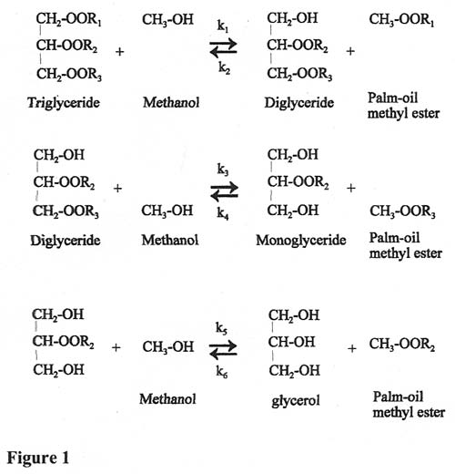
Chemical reaction

Slide 12
USES OF BIODIESEL FUEL
Biodiesel can be used in pure form (B100) or may be blended with petroleum diesel at any concentration in most injection pump diesel engines.
New extreme high-pressure common rail engines have strict factory limits of B5 or B20, depending on manufacturer.

Slide 13
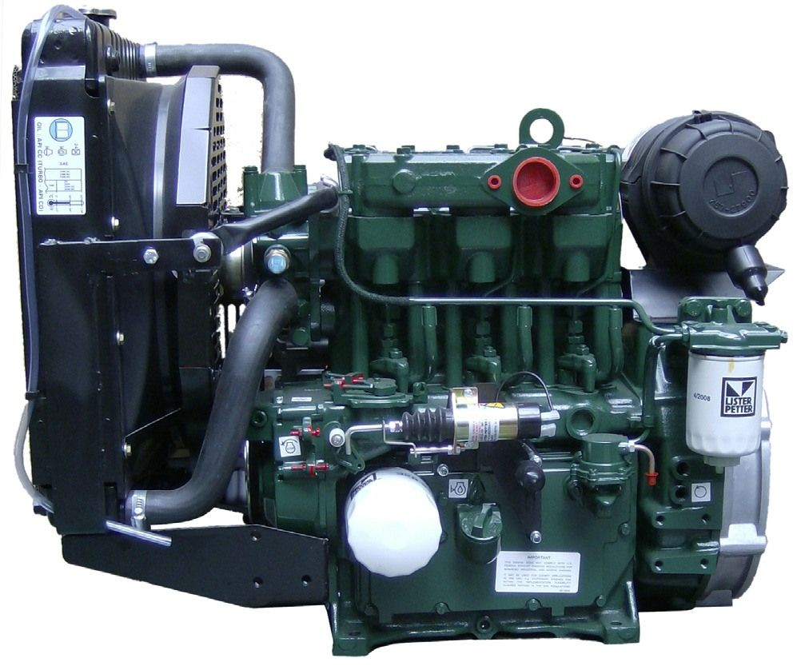

Slide 14
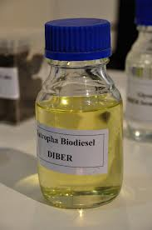
Vehicular use and manufacturer acceptance
Railway usage
Aircraft use
As a heating oil
Cleaning Oil Spills
Biodiesel in Generators
Biodiesel to Hydrogen-Cell Power: A microreactor has been developed to convert biodiesel into hydrogen steam to power fuel cells.

Slide 15
Advantages of biodiesel
Biodiesel does not contain sulphur.
There is reduction of unburned hydrocarbon.
There is 78.5% reduction in co2 emission.
It is bio-degradable,non-toxic.
It emits less green house gases.
It can be used in some of the diesel.

Slide 16
DISADVANTAGES OF BIODIESEL
Transportation and storage requires special management.
Involves additional land use, as land area is taken up.
Energy efficiency is less.
It is less suitable for use in low temperature.
It requires energy for production from the crops,animal fats.
It is expensive than pertroleum diesel fuel.
It is available in low quantity at present.

Slide 17
Winter Operations
Biodiesel blending must be carefully managed at cold temps
Treat as a fuel (WHMIS, safety, etc)
“Cleaning” / solvent effect (filters, tanks, hoses)
Storage - Moisture - “the enemy” Desiccant filters on tank vents
Long Term Storage - 9 months max, or use biocides with monthly examination
Fuel Handling
Tank Preparation
Properly cleaned, tested and vents are capped.

Slide 18
Pumps
Biodiesel improves lubricity
Should increase service life of sensitive injection pump models
Blends of B20 or greater not recommended for 1994 and older injection pumps due to deterioration of natural rubber components
Fuel Filters
- Use OEM recommended filters with correct micron rating
- Change at OEM recommended intervals after initial cleanout period
- Only use pre-filtered fuel in vehicles
- More frequent changes recommended in first 100 hours of operation
Hoses
- Fuel lines should be checked as part of regular maintenance
- Natural rubber hoses and seals may deteriorate and cause leaks with B100. - B20 data indicates no problems with natural rubber components

